Slide 1
New Shift table Algorithm For Multiple Variable Length String Pattern Matching
Author: Punit Kanuga
Presenter: Yi-Hsien Wu
Conference: 2015 International Conference on Circuit, Power and Computing Technologies [ICCPCT]
Date: 2017/9/5
Department of Computer Science and Information Engineering
National Cheng Kung University, Taiwan R.O.C.
Notes:
1

Slide 2
Outline
Introduction
Related Work
Concept And Algorithm
Result And Discussions
Conclusion

Slide 3
Introduction
Multiple string pattern matching can be summarised as a problem where objective is to simultaneously search presence of a set of strings (called patterns) in larger
string set (called text).
A shift table is a table which reflects maximum number of characters which can be skipped in text when mismatch happens while searching pattern in it
ensuring that no possible match is missed.
Overall, shift table reduces search time for searching patterns in text.
Notes:
When the controller is responsible for all the tasks it becomes a bottleneck and the solution does not scale well. (reason 2)

Slide 4
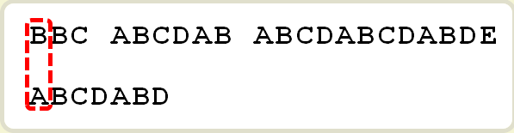
Related Work
Knuth, Morris, Pratt (KMP) algorithm :
search patterns within a larger string in time proportional to sum of lengths of all patterns .
Example :
Text : BBC ABCDAB ABCDABCDABDE
Pattern : ABCDABD
Notes:
When the controller is responsible for all the tasks it becomes a bottleneck and the solution does not scale well. (reason 2)

Slide 5
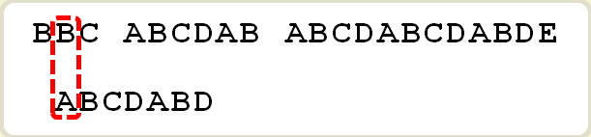
Related Work
Case 1 :
If text and searched character are not matched , shift right one character .
Case 2 :
If matched , continue to compare the character of pattern , until not match .
Notes:
When the controller is responsible for all the tasks it becomes a bottleneck and the solution does not scale well. (reason 2)

Slide 6
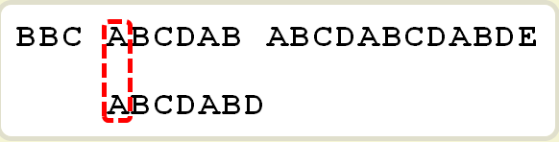
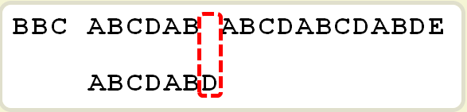
Related Work
Case 2 :
Start matched :
Not matched :
Shift =
Number of have matched -
Partial match Value
(Last matched character).
(6 – 2 = 4)
Pattern | A | B | C | D | A | B | D
Partial match value | 0 | 0 | 0 | 0 | 1 | 2 | 0
Notes:
When the controller is responsible for all the tasks it becomes a bottleneck and the solution does not scale well. (reason 2)

Slide 7
Related Work
Partial matched value : (Pattern : ABCDABD)
“A” : Prefix - NULL ; Suffix - NULL ; Length of common elements : 0
“AB” : Prefix - A ; Suffix - B ; Length of common elements : 0
“ABC” : Prefix – A,AB ; Suffix – BC,C ; Length of common elements : 0
“ABCD” : Prefix – A,AB,ABC ; Suffix – BCD,CD,D ;
Length of common elements : 0
“ABCDA” : Prefix – A,AB,ABC,ABCD ; Suffix – BCDA,CDA,DA,A ;
Length of common elements : 1 (A) .
“ABCDAB” : Prefix - A, AB, ABC, ABCD, ABCDA ; Suffix - BCDAB, CDAB, DAB, AB, B ; Length of common elements : 2 (AB) .
“ABCDABD” : Prefix - A, AB, ABC, ABCD, ABCDA, ABCDAB ;
Suffix - BCDABD, CDABD, DABD, ABD, BD, D ; Length of common elements : 0
Notes:
When the controller is responsible for all the tasks it becomes a bottleneck and the solution does not scale well. (reason 2)

Slide 8
Related Work
Boyer Moore :
Text : HERE IS A SIMPLE EXAMPLE ; Pattern : EXAMPLE
Compare the character from right to left , use 2 rules (bad character rule 、 good suffix rule) to choose the max shift.
Bad character rule : If the character in text is not match , find the character if it exist in the pattern , if true shift to align , else shift the full length.
Good suffix rule : shift the good suffix to align the pattern from head.
Notes:
When the controller is responsible for all the tasks it becomes a bottleneck and the solution does not scale well. (reason 2)

Slide 9
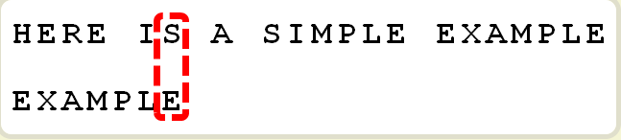
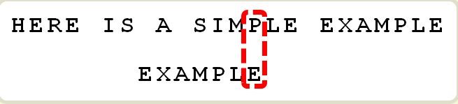
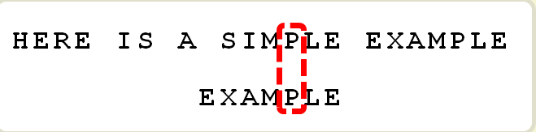
Related Work
Bad character rule :
1. Find if “s” exists in
pattern (EXAMPLE) , shift 7 .
2. “P” exists in pattern , shift 2 to
Align.
Size of shift = address of character – address of the rightest character exist in pattern . (If is not existed , minus -1)
Shift : 6 – (-1) = 7
Shift : 6 – 4 = 2
Notes:
When the controller is responsible for all the tasks it becomes a bottleneck and the solution does not scale well. (reason 2)

Slide 10
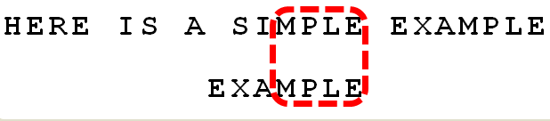
Related Work
Good suffix rule :
“E” , “LE” , “PLE” , “MPLE” are all good suffix .
Find if these suffix exist in the head of the pattern .
So “E” exist , shift to align .
Size of Shift = address of good suffix – character exist in pattern (If is not existed , minus -1).
Shift : 6 – 0 = 6
Notes:
When the controller is responsible for all the tasks it becomes a bottleneck and the solution does not scale well. (reason 2)

Slide 11
Concept And Algorithm
Define
Pattern : string which has to be searched .
Mismatch : Character in pattern where matching fails .
Join : Part of pattern matched before mismatch .
Leftover : Part of pattern which remained to match after mismatch.
Thus, overall pattern will be sum of “ leftover, mismatch and join “.

Slide 12
Concept And Algorithm
For multiple patterns, consider window of len-1 length, where len is the length of smallest pattern across multiple patterns.
Consider set of patterns P {aaba, aabab, aababc, aababcd,aababcde, abcb, zmnd, qope,jmqfm}.
Minimum length of pattern here is 4. Thus, size of window would be 3.

Slide 13
Concept And Algorithm
Consider pattern “aababc” :
Window 1 : aab
If mismatch happens at last character b, then we can shift this window by 1 towards right with respect to text to get nearest different character. Thus we consider shift table as {(b,1)}, ie, shift value of character b is 1.
If mismatch happen at middle character a, join = b and leftover is a.
Here we are sure that last character that was matched in text was b. There is no match of any part of join in leftover. So now shift table would be {(a,3), (b,1)}.
If mismatch happens at first character a, join = ab and leftover is NULL. There is no match of any part of join in leftover, neither ab or b alone. Now shift table remains as {(a,3), (b,1)}.

Slide 14
Concept And Algorithm
Window 2: aba
If mismatch happens at last character a, shift value for a will be 1 which is smaller than existing value for a in table. Thus, shift table will update as {(a,1), (b,1)}.
If mismatch happen at middle character b, join = a and leftover is a. Last matched character in text was a. Thus, we can shift pattern by 2 position to get align a (of join) with a (of
text). But existing shift value for a is 1 which is less than 2.
Thus, shift table remains as {(a,1), (b,1)}.
If mismatch happens at first character a, join = ba and leftover = NULL. There is no match of any part of join in leftover. So shift table remains as {(a,1), (b,1)}.

Slide 15
Concept And Algorithm
Window 3 : bab , Window 4 : abc
Same as window 2 and window 1 .
So shift table after input pattern “aababc” is {(a,1), (b,1),(c,1)}.
And continue to input another pattern “jmqfm” .
After calculate the shift table is {(a,1), (b,1),(c,1),(q,1), (m,1),(j,3),(f,1)}.

Slide 16
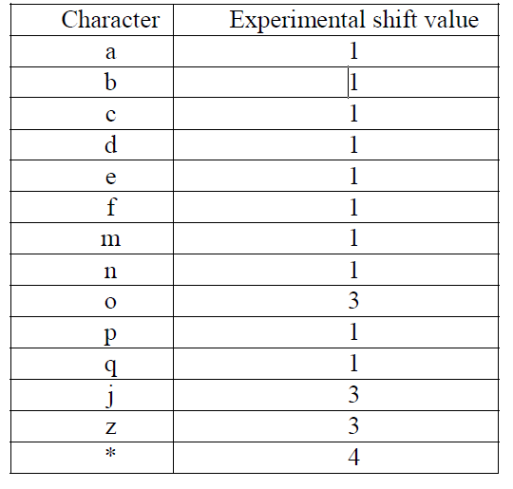
Concept And Algorithm
Shift table after input all of pattern in pattern set :
‘*’ represents all other characters of alphabet set except those mentioned.

Slide 17
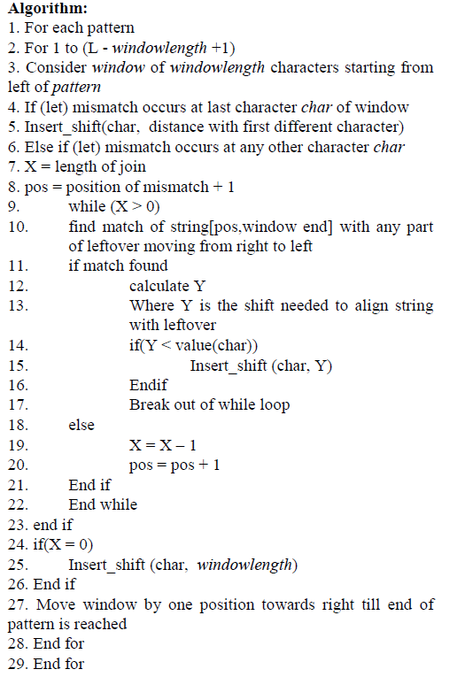
Algorithm

Slide 18
Result And Discussions
For a single pattern with :
P: Length of single pattern , W: Size of window
Mathematically runtime of this algorithm on single pattern will be O(P-W+1).
Effectively, runtime complexity will be O(P) considering pattern to be much larger than window.
For a set of variable length patterns with :
X: Number of pattern , N: Sum of lengths of all patterns
M: Average pattern length , L: Smallest pattern length, thus W=L-1
Mathematically runtime of generating shift table by presented algorithm is O(N/M*(M-W+1)).
Considering, N is much larger in comparison to L, effectively runtime complexity for presented algorithm can be given as O(N).

Slide 19
Conclusion
A shift table algorithm which is able to solve problem of variable length multiple string pattern matching is presented.
This is inspired by Boyer Moore concept for single pattern matching.
It further successfully enhances that concept to gain promising results.
With use of table to search occurrence of join in leftover this algorithm takes O(|P|) time where |P| defines sum of all pattern lengths.
As shown in results section, it produces shift table which works well with existing multiple string pattern matching algorithms.
This shift table algorithm ensures that we are able to pre-process pattern set for successful search in case of both static as well as dynamic text.

